Slide 1
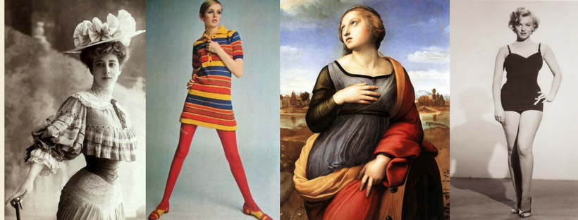
The Evolution of Beauty Standards

Slide 2
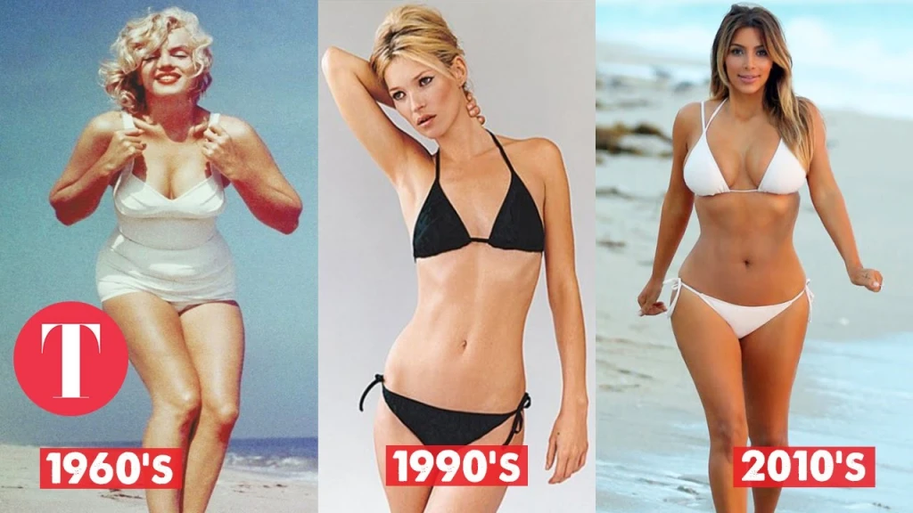
In the United States, “beauty” is often white, female, and thin. Even with discussions of “curvy”, we are still privileging thin bodies as the standard of beauty. Beauty is commercialized and considered something you can buy with surgery, cosmetics, or dieting schemes.
Notes:
Corsets, bustles, push-up-bras, control-top pantyhose: each designed to discipline and “perfect” the female body. Of course, clothing fashions change along with changing standards of female beauty. While corsets and bustles emphasized impossibly small waists, broad hips and large posteriors, today’s fashions often emphasize large breasts and flat, toned mid-sections. But what does fashion have to do with the way we feel about our bodies? What can a critical analysis of fashion tell us?
Fashion Trends Can Tell Us About Gender Relations In A Given Society At A Particular Time.
For instance, women’s fashions shifted from the restrictive full-length skirts and tight bodices of the 19th century to the shorter split-skirts advocated by women’s rights campaigners at the turn of the century to the skin-baring “flapper” dresses of the 1920s. We can see that as some of the social, economic and legal restrictions on women began to ease, women’s fashions became less restrictive. It is worth considering, however, whether at some point more revealing and more form-fitting fashions for women become almost as oppressive to women as the corsets and bustles of earlier eras.

Slide 3
We spend $20 billion dollars a year on cosmetics.
That’s enough to pay for…
2,000 women’s health clinics;
33,000 battered women’s shelters;
400,000 four-year university scholarships;
200,000 vans for safe nighttime transport;
1 million highly paid child care workers; or
1 million home health aids for the elderly.

Slide 4
Consider This
Americans now spend more than $40 billion dollars a year on weight loss products and programs.
90 percent of American women consider themselves overweight, and almost half of them are dieting
Americans spend an additional $15 billion each year on cosmetic surgery

Slide 5
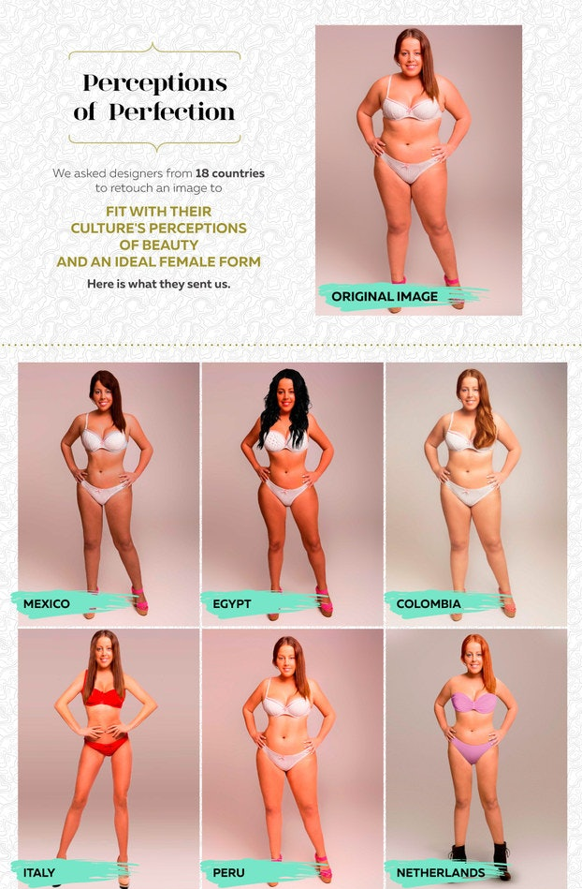
Standards of beauty are arbitrary, and they vary greatly from one culture to another and over time.
Notes:
Such variations in ideals of beauty often reflect the roles women and men are expected to fulfill in a given society. For instance, in contexts where women are valued mainly for their fertility—their ability to bear and nurture children—often full-bodied women with broad hips and ample breasts are considered the most beautiful. In societies such as Fiji, large bodies are a symbol of one’s status and power. It is not surprising, therefore, that individuals who would be classified as obese in the US are considered the most attractive and desirable members of this culture.
But as social conditions and gender roles change, so do ideas about beauty. Consider some recent changes in the US. In the 1960s and 70s, beauty ideals for women shifted from the mature curvaceous body of stars such as Marilyn Monroe to the stick-thin, flat-chested figure epitomized by supermodels such as Twiggy or Kate Moss. The compelling fact here is that just as women started to make dramatic gains in the areas of education, employment and politics, the ideal female body began to look like a malnourished preadolescent girl, weak, emaciated and non-threatening. Women may have been gaining in freedom and power, but they were increasingly encouraged to discipline their bodies through diet and exercise to conform to ideals that were almost impossible to achieve.

Slide 6
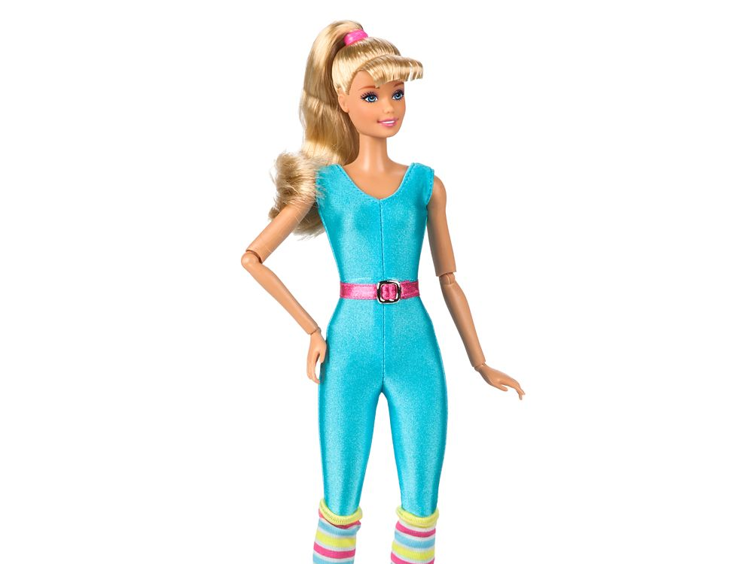
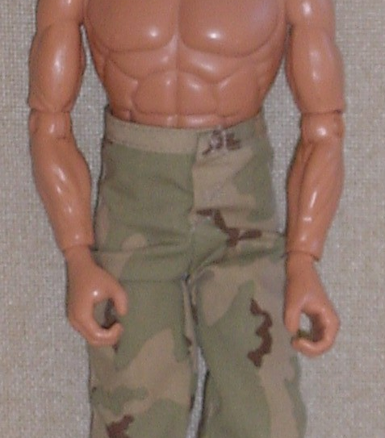
GI JOE & BARBIE
How are ideas about beauty instilled in children? What are the core differences between Barbie and GI Joe? How are these toys played with and by whom? What is their purpose?

Slide 7
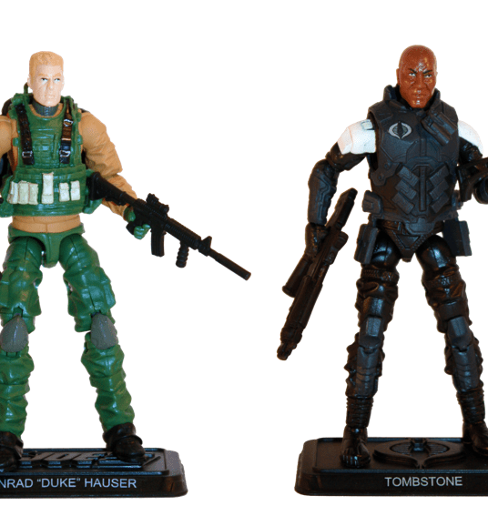
GI JOE
Boys and men are powerful and important.
Boys and men do great things and are recognized for their deeds.
Boys and men fight the bad guys and protect the innocent and the weak.
Boys and men should have large, powerful bodies with sculpted muscles.
Boys and men should be willing and able to use their bodies to commit morally justified acts of violence.
The only real men are “tough guys.”
A negative body image for boys and men, especially those labeled as “fat” or “weak,” and the development of unhealthy practices to cope with feelings of frustration and shame
The potentially life-threatening use of steroids to build muscle mass
The socialization of boys and men to violence and dominance.
Notes:
irst, as most boys quickly remind you, GI Joes are not dolls. They are “action figures.” And this separate terminology reveals the very different meanings toys such as GI Joe and superhero figures convey. Typically, these toys are not designed to be dressed up and admired for their appearance. Product packaging shows them staging daring rescues and fighting battles. In stark contrast with Barbie, boys’ action figures seem to teach children that:
Boys and men are powerful and important.
Boys and men do great things and are recognized for their deeds.
Boys and men fight the bad guys, and protect the innocent and the weak.
And yet, recent decades have seen boys’ action figures become impossibly, even grotesquely muscular. Some recent dolls have biceps bigger than their heads—not a positive message about brain vs. brawn. Jackson Katz, in his documentary Tough Guise, observes that the GI Joe doll’s biceps have been steadily enlarged over the years to the point that the figure’s body proportions are virtually impossible for any real man to attain. What’s more, Katz points out that such toys are just one source of messages in our culture that associate masculinity with violence—heroic, morally justified violence in this case, but violence nonetheless. One current line of professional wrestling action figures is promoted as the “Ruthless Aggression” series. Thus, among the potential harmful messages conveyed by action figures, we might include the following:
Boys and men should have large, powerful bodies with sculpted muscles.
Boys and men should be willing and able to use their bodies to commit morally justified acts of violence.
The only real men are “tough guys.”
Again, the psychological and behavioral effects of being exposed to these messages are hard to gage. However, potential negative effects include
A negative body image for boys and men, especially those labeled as “fat” or “weak,” and the development of unhealthy practices to cope with feelings of frustration and shame
The potentially life-threatening use of steroids to build muscle mass
The socialization of boys and men to violence and dominance.

Slide 8
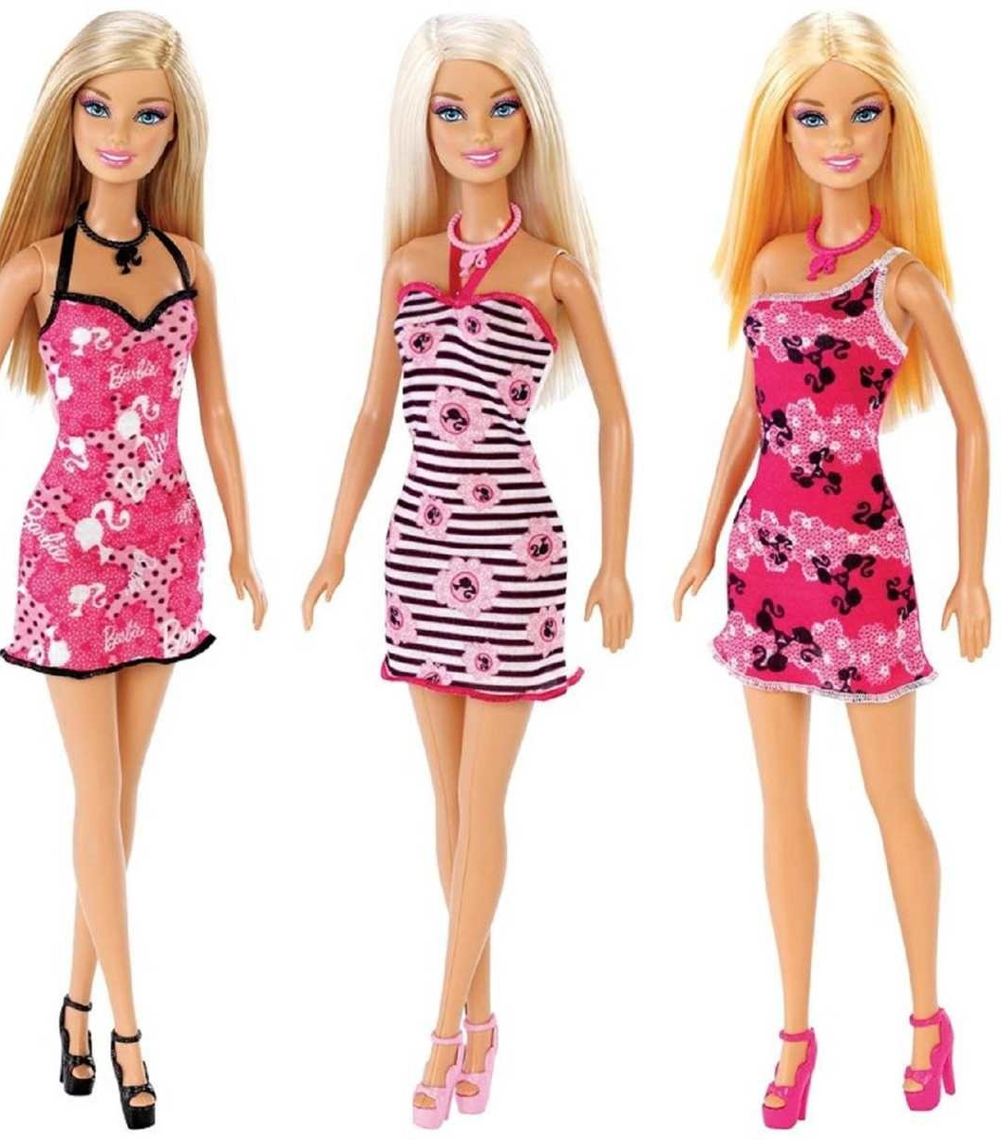
The ideal female body is stick-thin and big-breasted.
The natural, healthy female body is unattractive.
Women’s value rests in their physical appearance and accessories
Girls and women must have well-disciplined bodies, meticulously groomed hair and make-up, and a carefully coordinated and fully accessorized wardrobe.
Spend, spend spend! Diet, diet, diet! And live at the gym if you must!
Girls and women are judged more on how they look, than on what they do.
Even in her career roles, Barbie is well accessorized
Mattel has introduced some career-themed Barbies in recent years, but the fashion-oriented dolls (along with the bride and princess) are the perennial best-sellers.
BARBIE
Notes:
In the last three decades, the humble Barbie doll has come in for a lot of criticism. While many feminist researchers have suggested that Barbie represents an unattainable body ideal that damages girls’ self-esteem, the doll’s defenders have argued that Barbie is, after all, “just a toy” and is unlikely to create any lasting psychological effects.
What is indisputable, however, is that the Barbie’s body dimensions are very far outside the “normal” range. In a [2003] study, Urla and Swedlund calculated that if Barbie were full size, her measurements would be 32-17- 28, typical of a woman suffering from anorexia. Add to this anorexic frame her large gravity-defying breasts and you have a body ideal that is virtually impossible for a healthy, non-surgically altered woman to attain.
Although it is unlikely that children playing with Barbies consciously compare their own bodies to those of their dolls, it would be naïve to assume that they do not pick up on the powerful messages embodied by this cultural icon. Among these messages we might include the following:
The ideal female body is stick-thin and big-breasted.
The natural, healthy female body is unattractive.
To be attractive and popular, girls and women must have well-disciplined bodies, meticulously groomed hair and make-up, and a carefully coordinated and fully accessorized wardrobe. (Subtext: Spend, spend spend! Diet, diet, diet! And live at the gym if you have to!)
And, perhaps the overriding message: Girls and women are judged more on how they look, than on what they do. Although Mattel has introduced some career-themed Barbies in recent years, the fashion-oriented dolls (along with the bride and princess) are the perennial best-sellers.
It is difficult to measure any negative psychological or behavioral effects that early and intense exposure to such messages may have. Such measurement is difficult primarily because such messages are so pervasive in our culture today. Summer (1996: 14) noted of fashion advertising, for instance, the prevalence of “concentration-camp-thin models with pasty complexions sporting blackened eyes, limp hair, and designer outfits.” However, with 80% of 10-year-old girls now dieting to control their weight, and most American women struggling daily to make their bodies conform to unrealistic ideals, few could argue that Barbie and her kind contribute to the development of positive body image among girls and women.

Slide 9
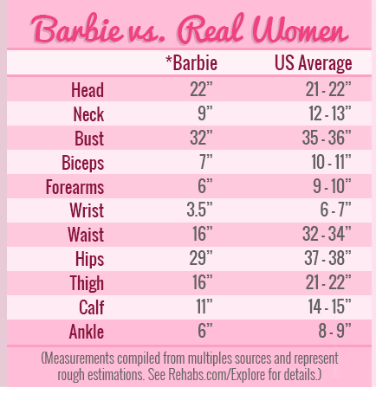
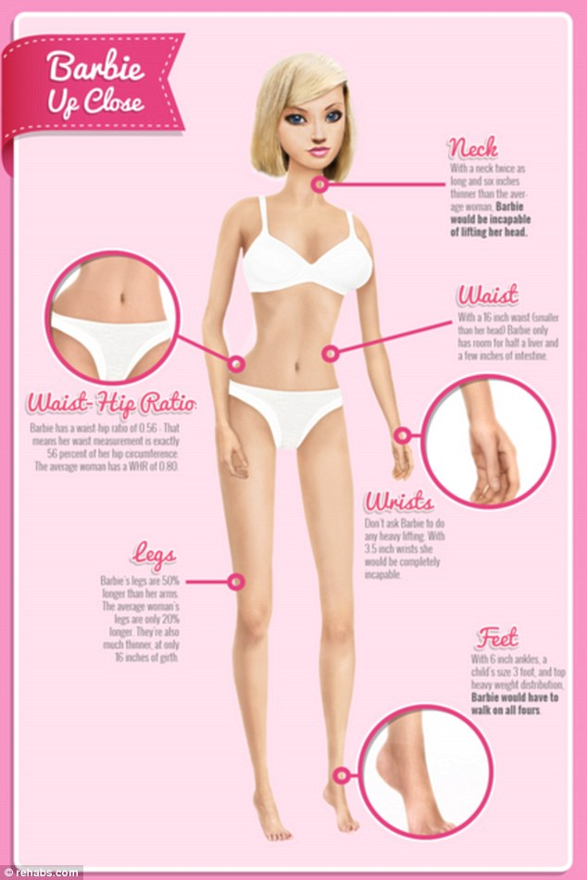

Slide 10
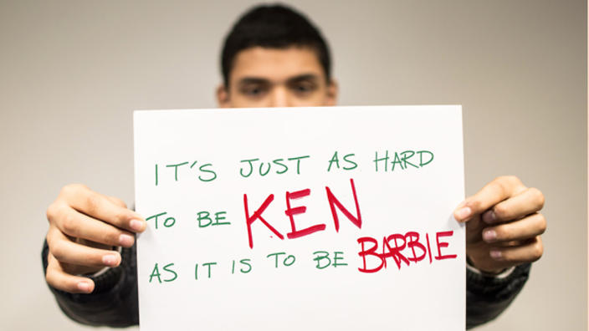
Male body image is distinguished from female body image in several ways:
Men seem to be more prone to ‘atypical’ eating disorders and substance abuse than women
Men tend to be quieter about their body negativity, seeking treatment less frequently or holding off on treatment longer than women due to shame Women, however, internalize more, body shame more, and body surveillance more than men
Some researchers say men are typically more satisfied with their physical appearance and less likely than women to exhibit body-change behaviors
But other researchers insist that men still struggle with body image: They say men are caught “feeling either too thin or too heavy to meet the male ideal”
Notes:
Male body image also tends to be more misunderstood than female body image. Men are presumed to be mainly concerned with a “perceived lack of muscle,” when in fact male body image can be much more complex (See the first page of Male Body Image). On the other hand, the presumed concern for females is not as off the mark: weight.
It may seem unhealthy female body image is more prevalent than unhealthy male body image, but that may only be a perception: some researchers claim that women are simply exposed to more social situations that make them feel dissatisfied with their bodies, so the numbers reflect that women are more dissatisfied than men (Brennan, Lalonde, & Bain 2010). This clarifies why female body image is so prevalent whereas male body image is rarely recognized.
These differences of how the sexes relate to negative body image are important when it comes to recognizing it in males. It is critical we turn attention to male body image as much as we validate and seek to make it positive for women. For more information about how men develop unhealthy body image, check out Causes & Factors for Boys or Causes & Factors for Men. Or, head to Effects of Body Image to learn about the damaging outcomes of negative body image on males.
A massive “95% of college age men are dissatisfied with their bodies on some level” (Daniel & Bridges 2013). That’s a huge portion of each campus’s population! We need to pay more attention to male body image and the struggles men may face when coming to terms with their imperfect bodies. Just as today’s society expects women to become thinner with statuesque features, American men, and men all across Western cultures, feel pressure to pump up their bodies and slim down, creating a combination of lean, bulky muscle. However, unhealthy male body image extends beyond the average college man.
According to a study, over 90% of men struggle in some way with body dissatisfaction and negative affect (negative opinions of self), or negative emotions and thoughts towards one’s body (Castonguay et al. 2014). Research also shows that body image disorders may be more severe in both gay and heterosexual teenage-through-young-adult (post-college) males than men in other age categories (Burlew & Shurts 2013).
As a culture we know very little about the prevalence of this issue in men and boys since body image is traditionally considered a ‘female problem’. The fact is, men can suffer just as much body dissatisfaction as women, but we may pay less attention to male body image because men are quieter about these problems: Men tend to seek treatment, counseling, or positive solutions less frequently, or they hold off on doing so out of shame and embarrassment (Burlew & Shurts 2013).
We need to encourage men to be more open with their views on body image and give more attention to promoting healthy, realistic male body image as much as we do for females.

Slide 11
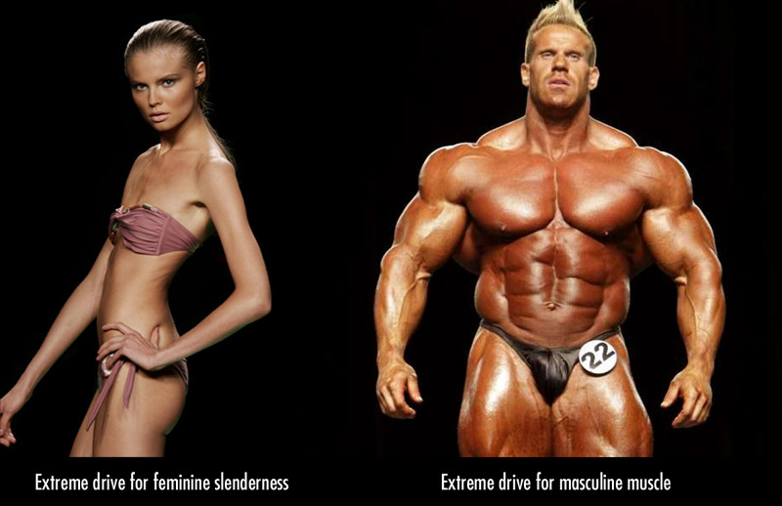
Questions for consideration:
What do you think of today’s body image standards for men? How do they compare with those for women?
Why might men receive the same pressure as women to achieve the ‘perfect’ body? Do they get the same pressure?
Why is it okay for women to dress in menswear-style suits, but unacceptable for men to dress in skirts, lace or anything considered “feminine”?
Which is more oppressive to women? Victorian era corsets, full skirts, bonnets and gloves OR the pressure to wear low-cut form-fitting shirts and tight ultra-low-rise jeans?
Is cosmetic surgery truly a personal choice?
If reading or watching something that pushes standards of beauty makes us feel bad about our appearance, why do we continue to watch or access the content?

Slide 12
Why is it okay for women to dress in mensware-style suits, but unacceptable for men to dress in skirts, lace or anything considered “feminine”?
Which is more oppressive to women? Victorian era corsets, full skirts, bonnets and gloves OR the pressure to wear low-cut form-fitting shirts and tight ultra-low-rise jeans?
Is cosmetic surgery ethical?
If reading or watching something that pushes standards of beauty makes us feel bad about our appearance, why do you think we continue to watch or access the content?

